Slide 1
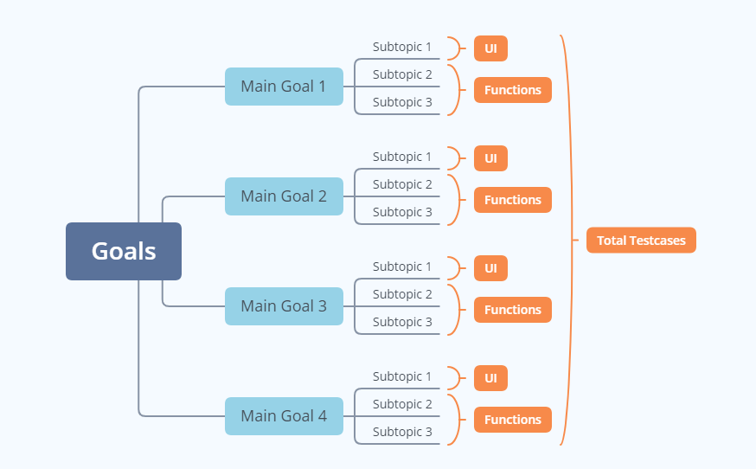
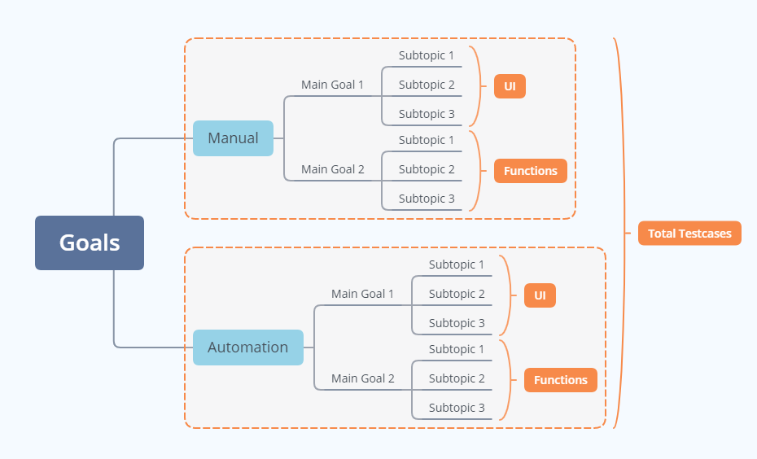
Testcases Tree for Regresion
Current
Proposal
What?
Total time = Testers * Velocity
Both values are final which is a problem.
How?
- Automate part of the goal to reduce total time.
- Simply move the manual testcase to the Automate sub-tree when it's automated.
- Automated testcase Velocity is scaleable.

Slide 2
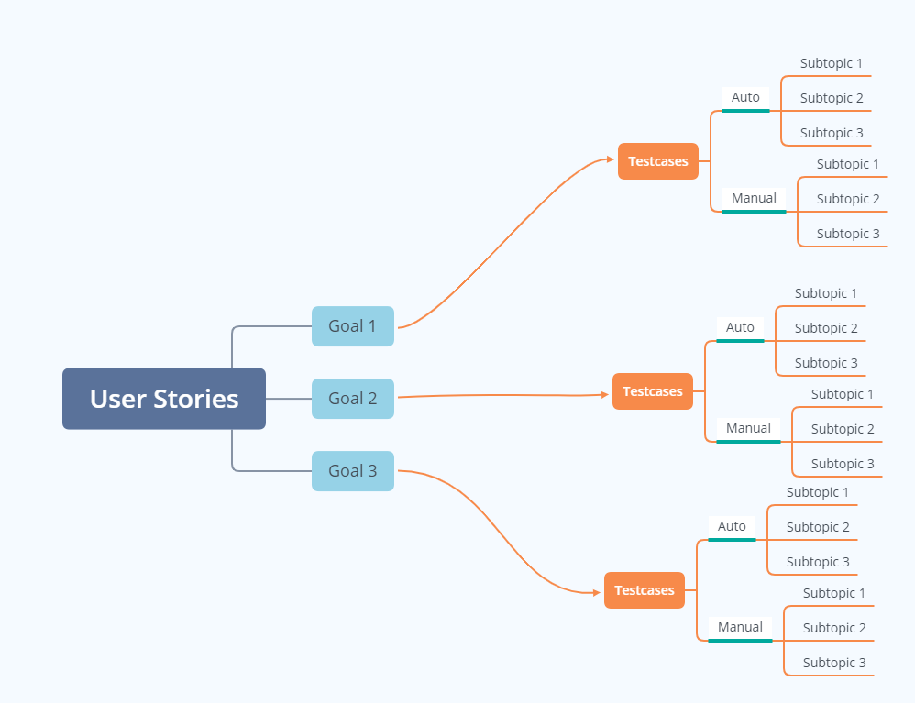
Testcase Tree for Acceptance Test
What?
Cover most of User Stories in testcases.
How?
- Automate part of the goals to reduce total test time.
- Simply move the manual testcase to the Automate sub-tree when it's automated.

Slide 3
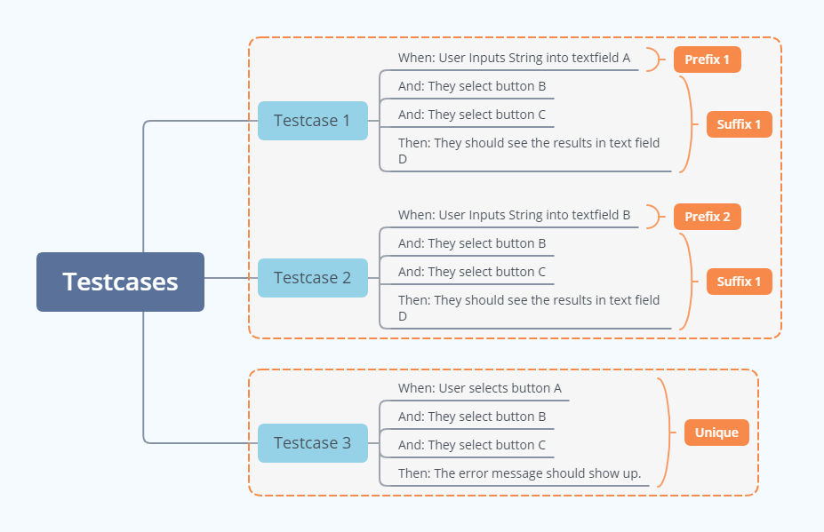
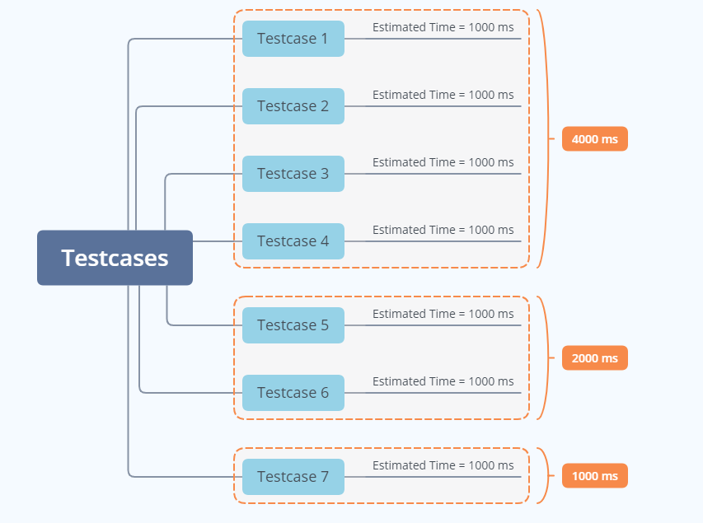
Priority to Maximize Testcase Value 1
1. Weights: Common Steps
2. Profits: Manual Test Time Reduction
What?
Test-cases prioritization
How?
Maximize the time reduction by sorting the testcases.
Patterned steps for resuseable scripts
Estimated test time for all testcases
Highest value when combining Weights and Profits.

Slide 4
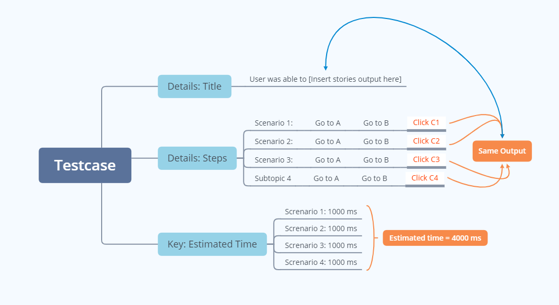
Priority to Maximize Testcase Value 2
What?
Test-cases Optimization
How?
1. Title should reflect the Outcome
2. Multiples scenario should be in a single testcase
3. Total Estimate time show the weight of a testcase
Why?
1. 2. To advoid duplication testcase by grouping.
3. Just an update.

